Slide 1
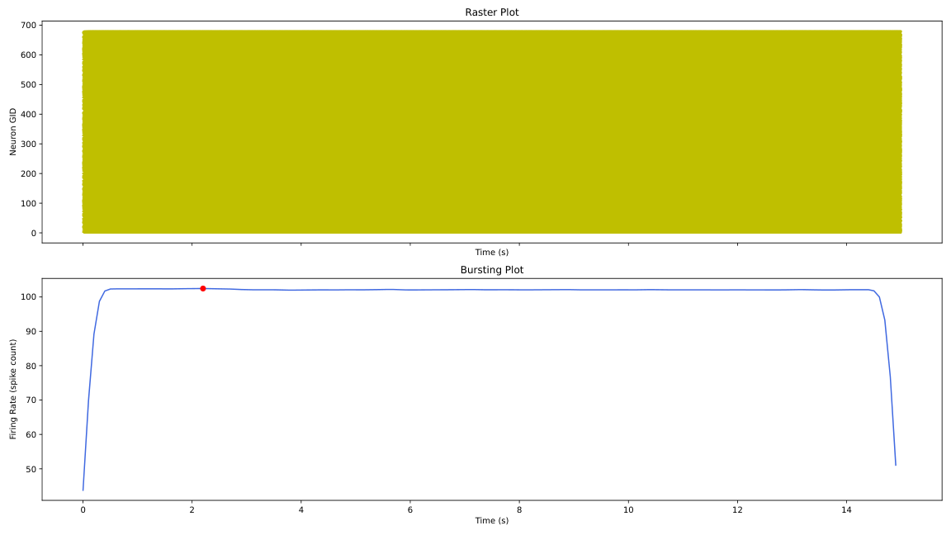
gen_2_cand_69, Page 1

Slide 2
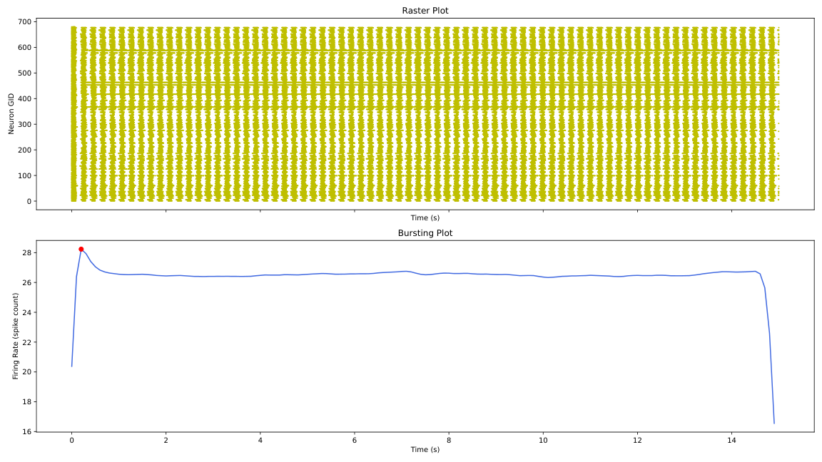
gen_2_cand_38, Page 1

Slide 3
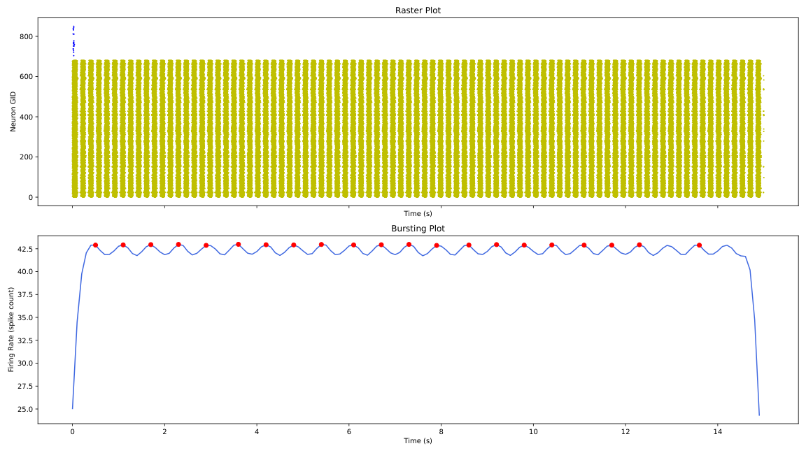
gen_2_cand_40, Page 1

Slide 4
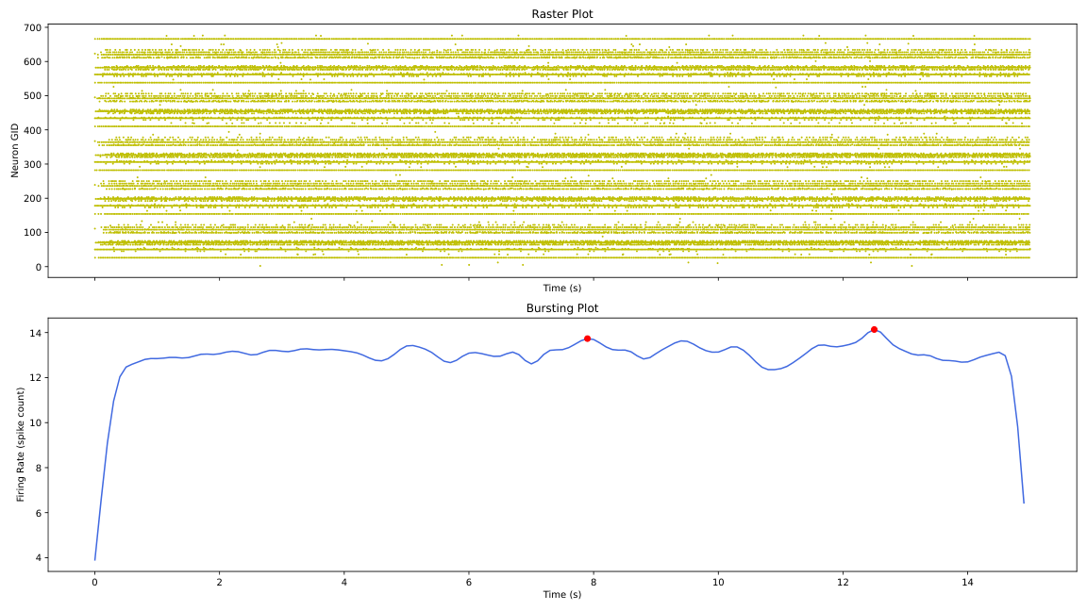
gen_2_cand_46, Page 1

Slide 5
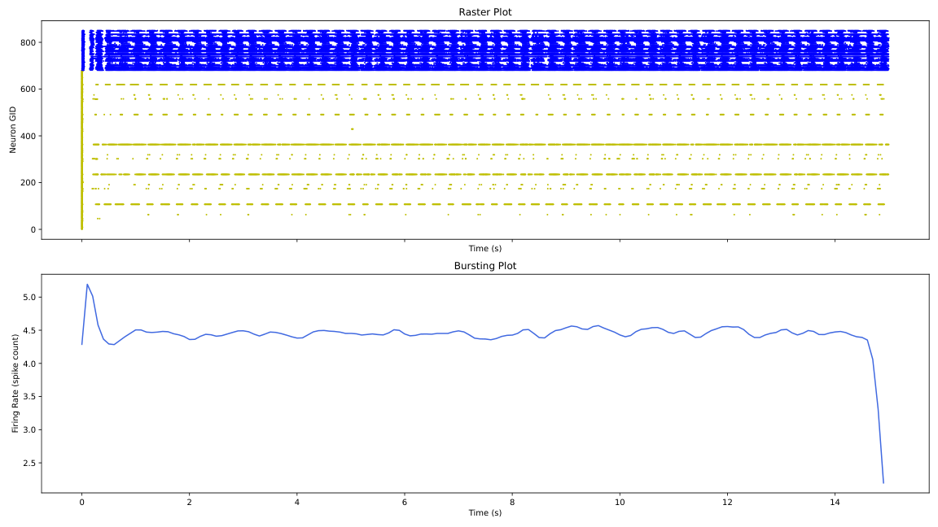
gen_2_cand_25, Page 1

Slide 6
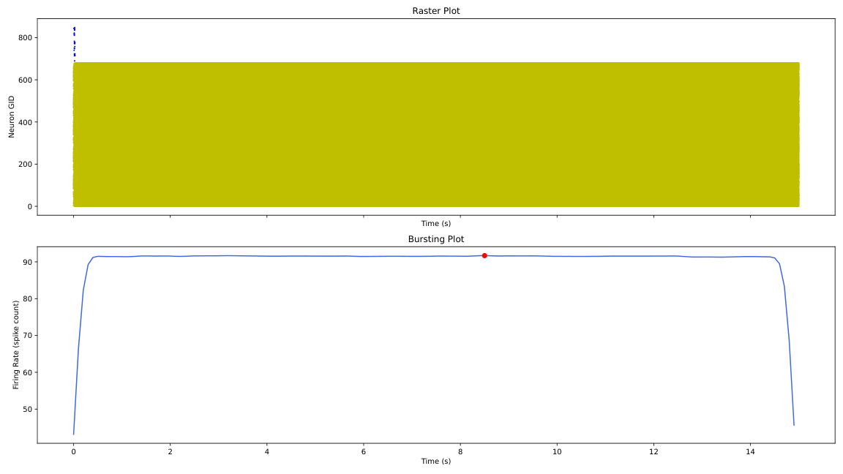
gen_2_cand_89, Page 1

Slide 7

gen_2_cand_30, Page 1

Slide 8

gen_2_cand_53, Page 1

Slide 9
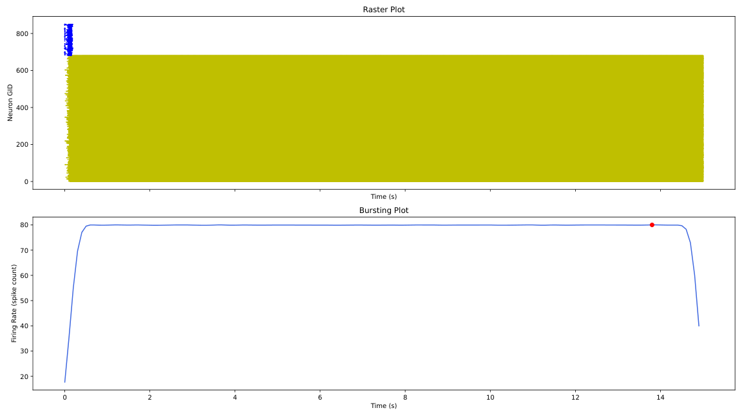
gen_2_cand_42, Page 1

Slide 10
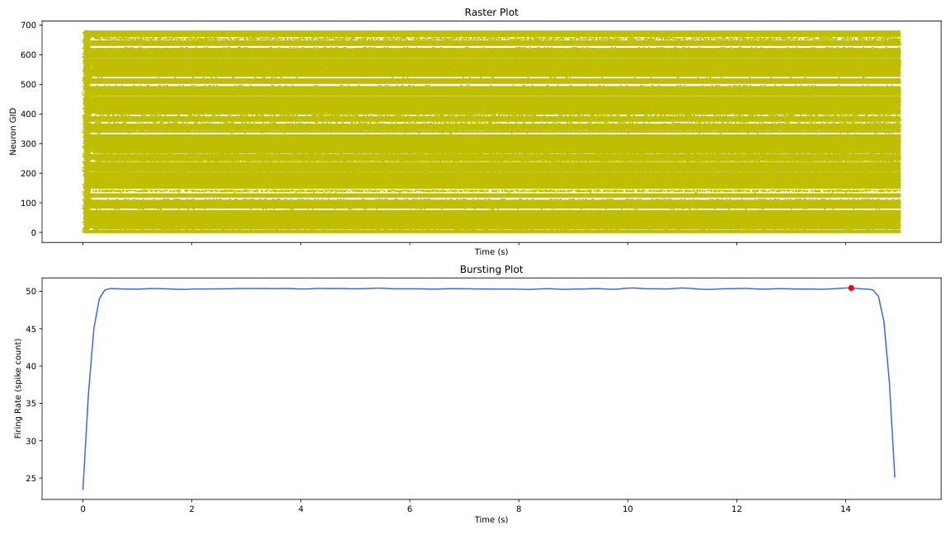
gen_2_cand_2, Page 1

Slide 11
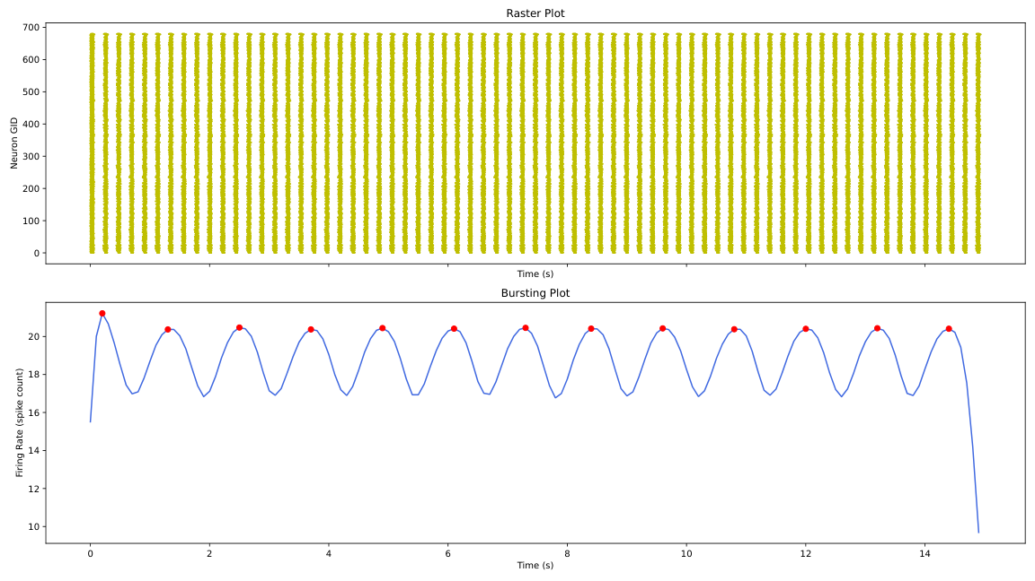
gen_2_cand_5, Page 1

Slide 12
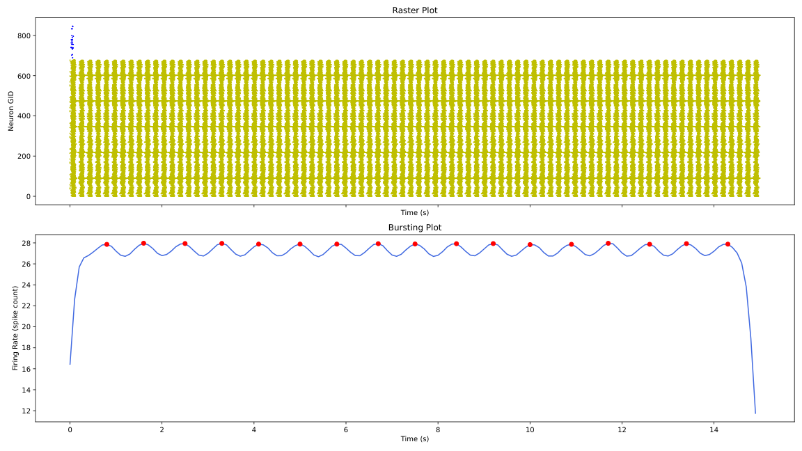
gen_2_cand_6, Page 1

Slide 13
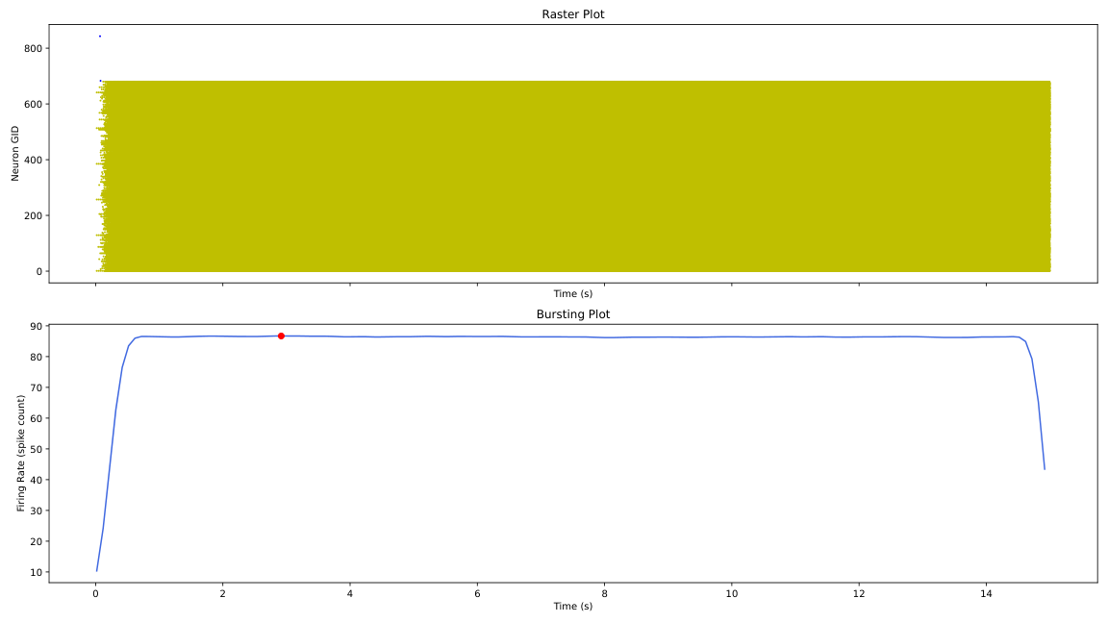
gen_2_cand_90, Page 1

Slide 14
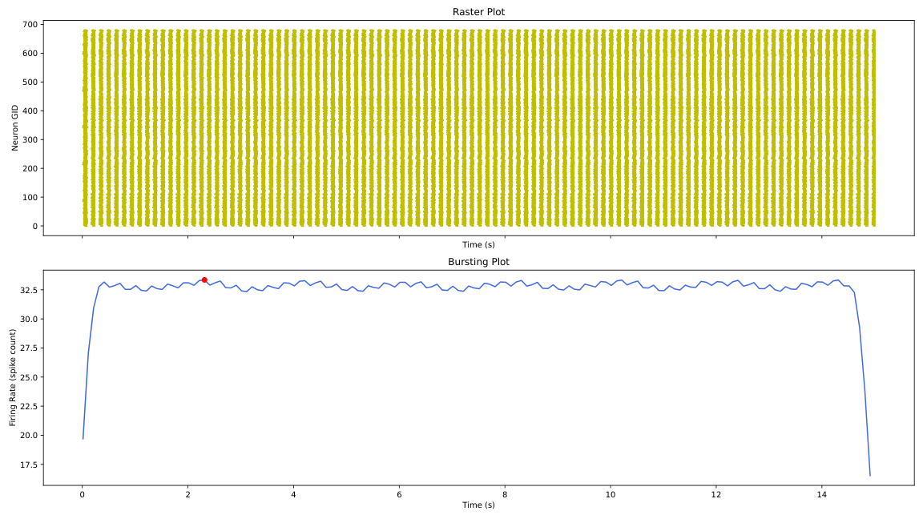
gen_2_cand_95, Page 1

Slide 15
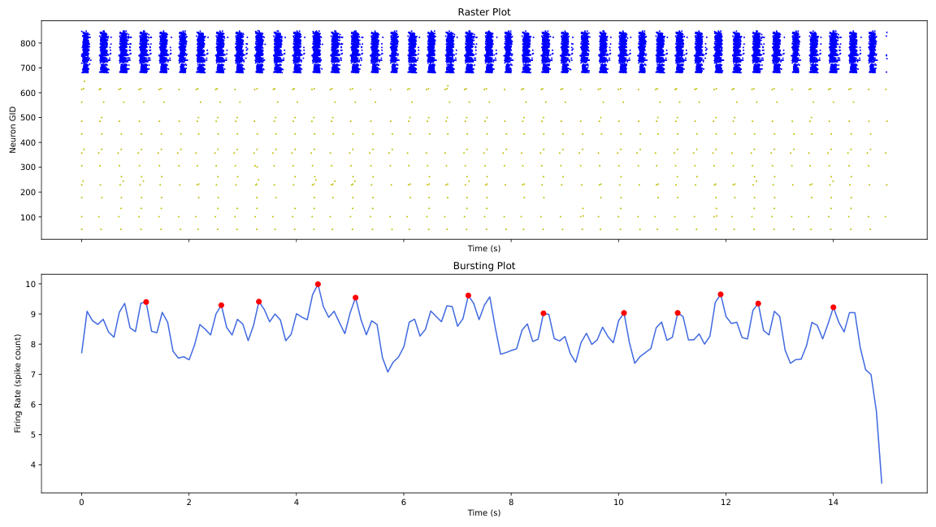
gen_2_cand_39, Page 1

Slide 16
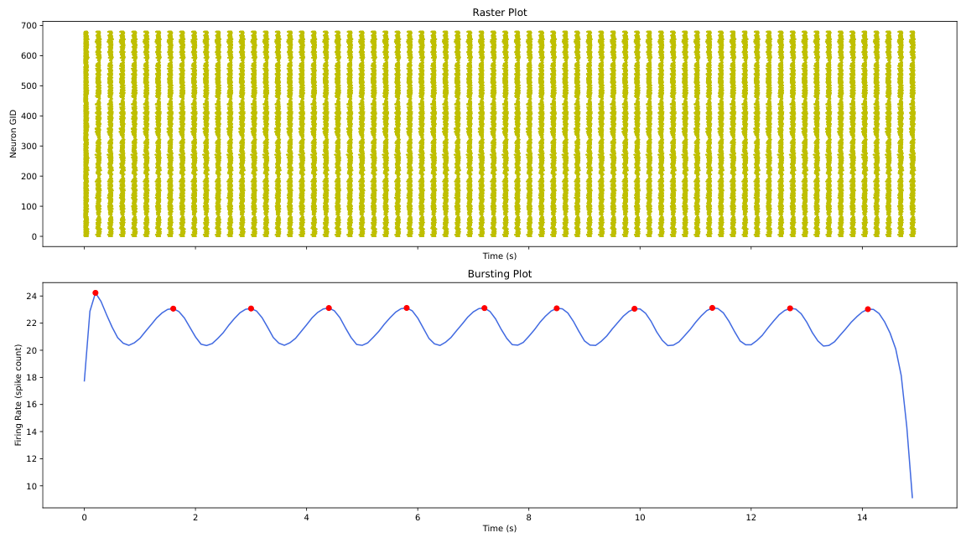
gen_2_cand_52, Page 1

Slide 17
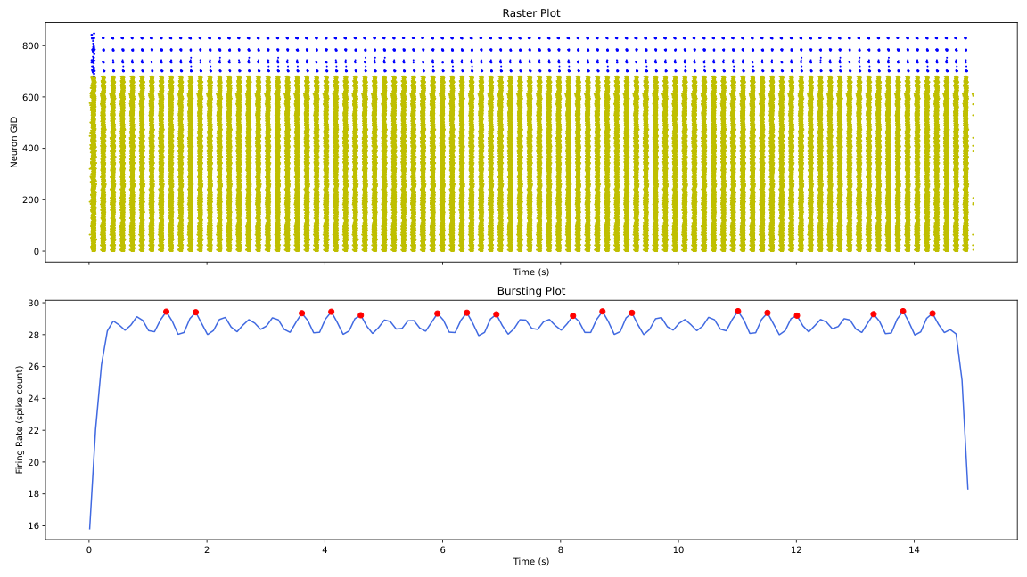
gen_2_cand_48, Page 1

Slide 18
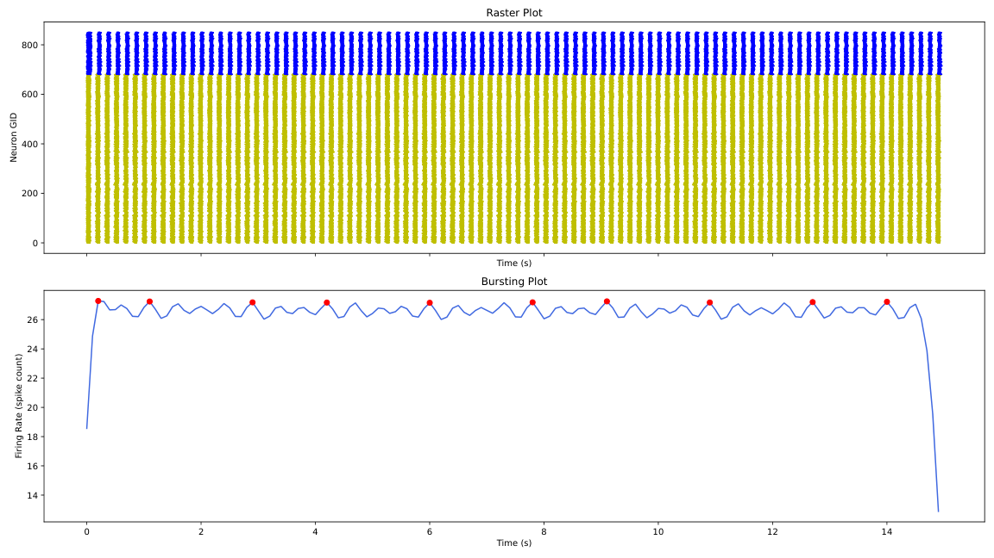
gen_2_cand_79, Page 1

Slide 19
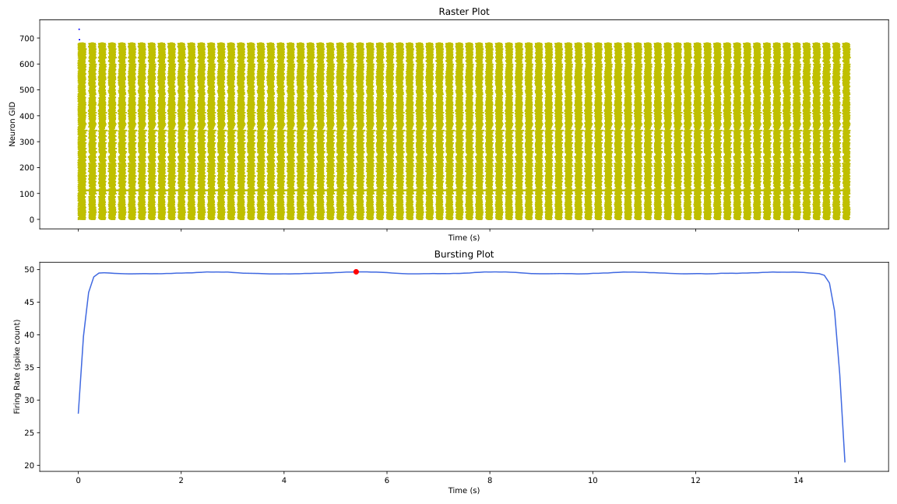
gen_2_cand_28, Page 1

Slide 20
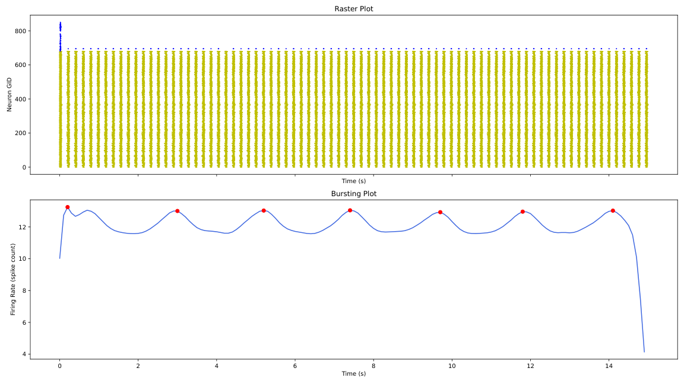
gen_2_cand_97, Page 1

Slide 21
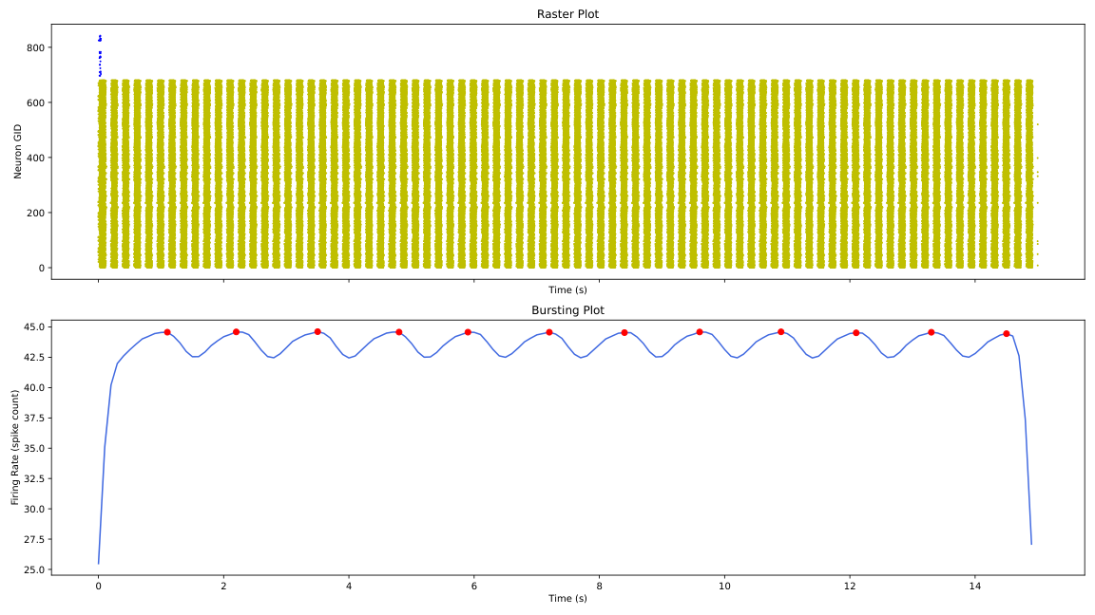
gen_2_cand_77, Page 1

Slide 22

gen_2_cand_87, Page 1

Slide 23
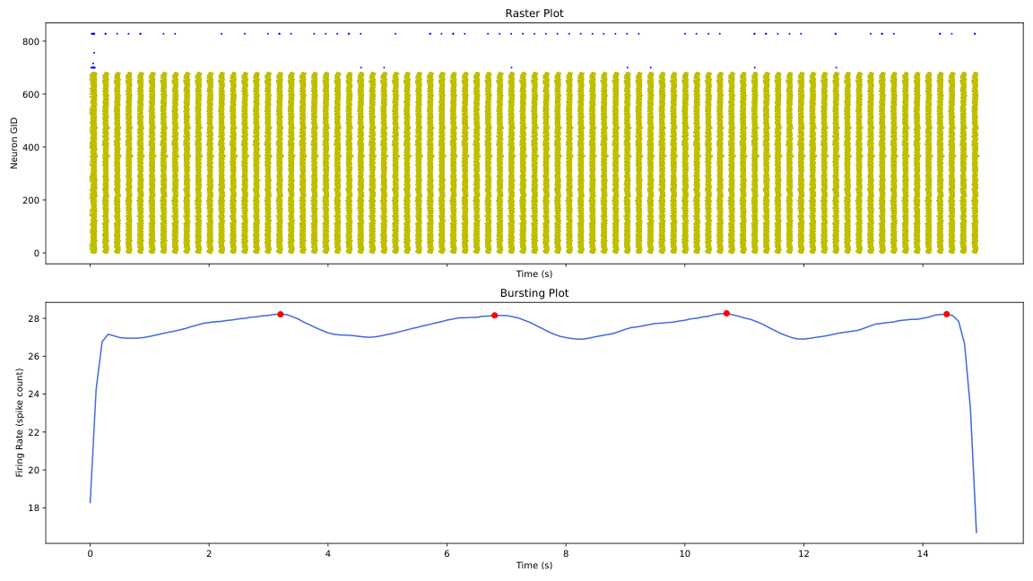
gen_2_cand_21, Page 1

Slide 24
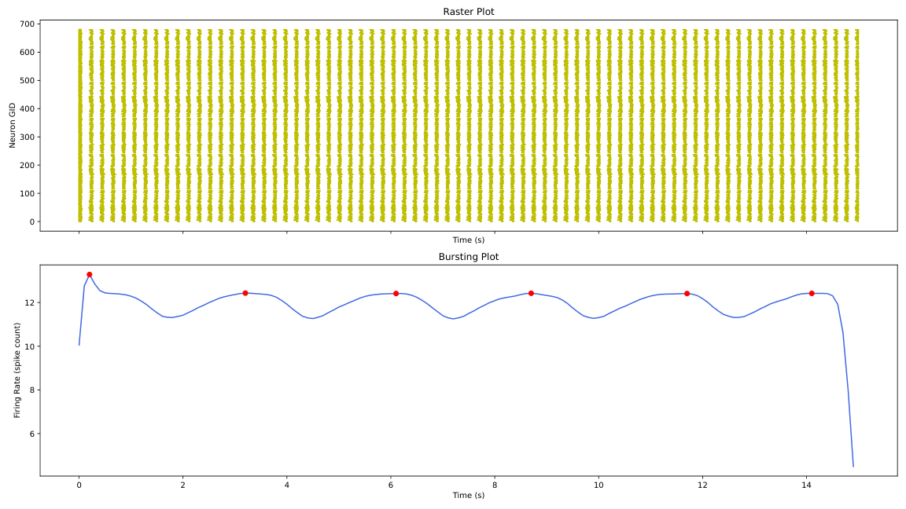
gen_2_cand_66, Page 1

Slide 25
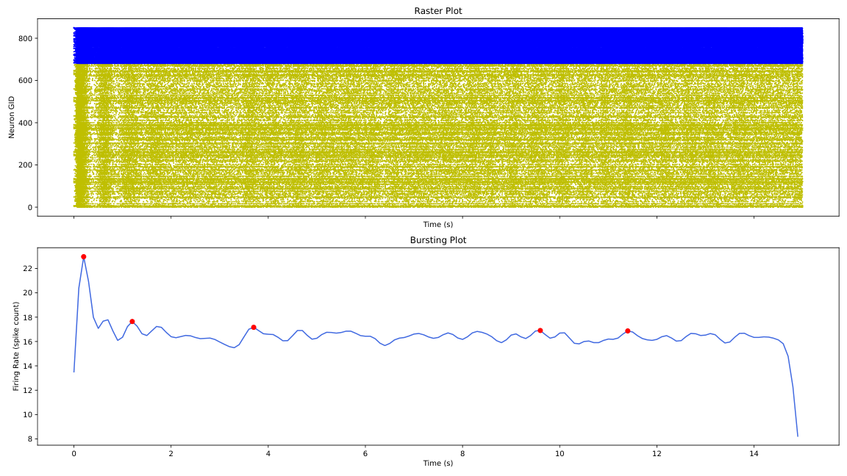
gen_2_cand_31, Page 1

Slide 26
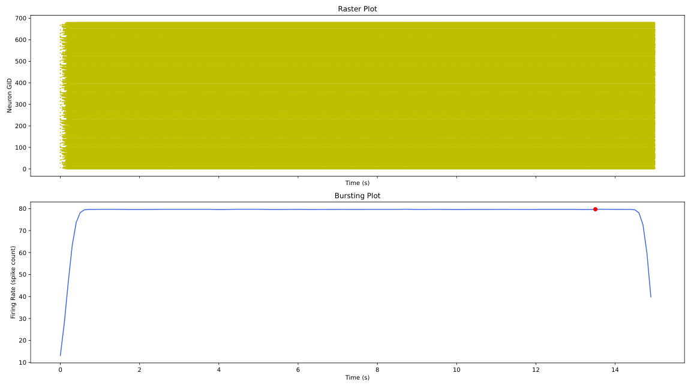
gen_2_cand_64, Page 1

Slide 27
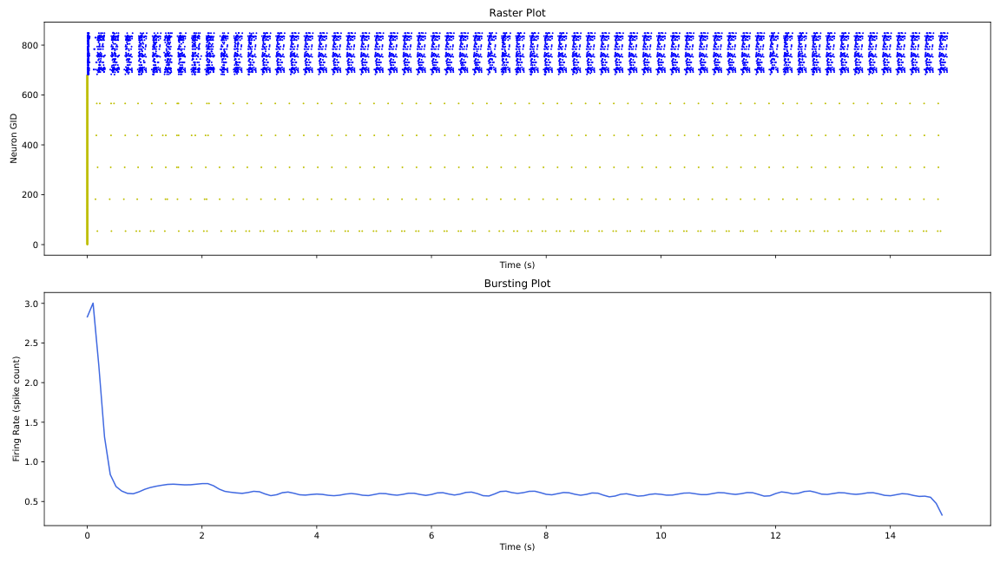
gen_2_cand_41, Page 1

Slide 28
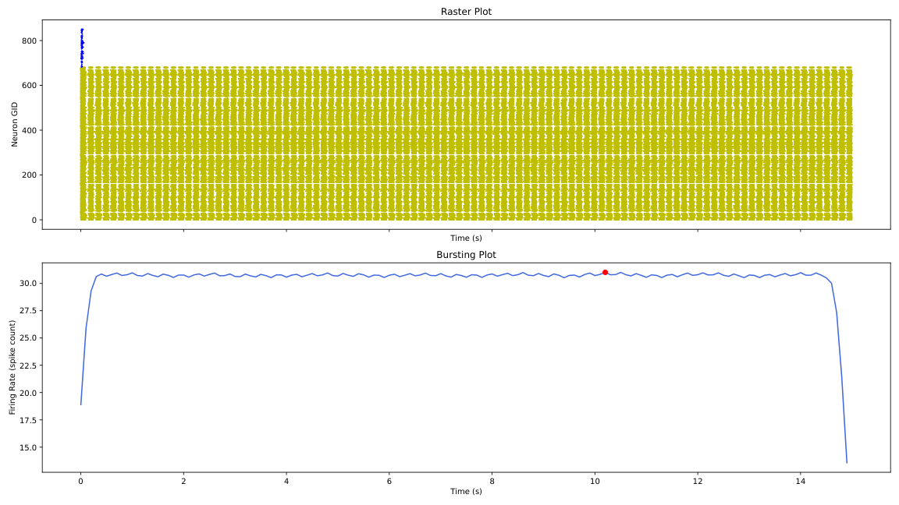
gen_2_cand_35, Page 1

Slide 29
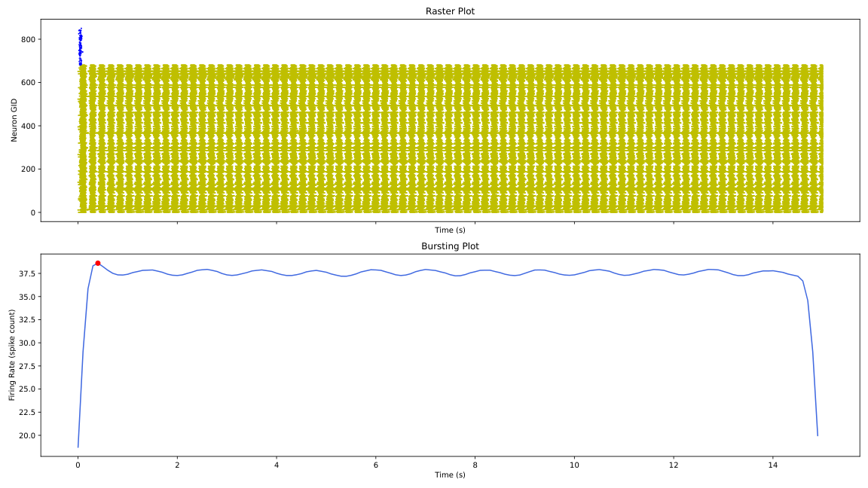
gen_2_cand_16, Page 1

Slide 30
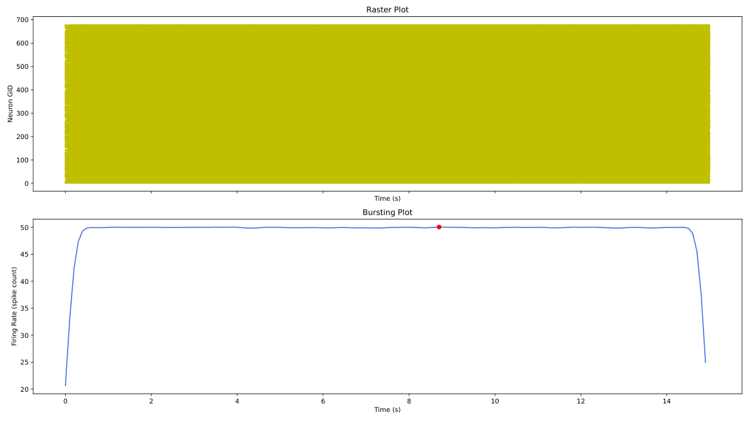
gen_2_cand_70, Page 1

Slide 31

gen_2_cand_44, Page 1

Slide 32
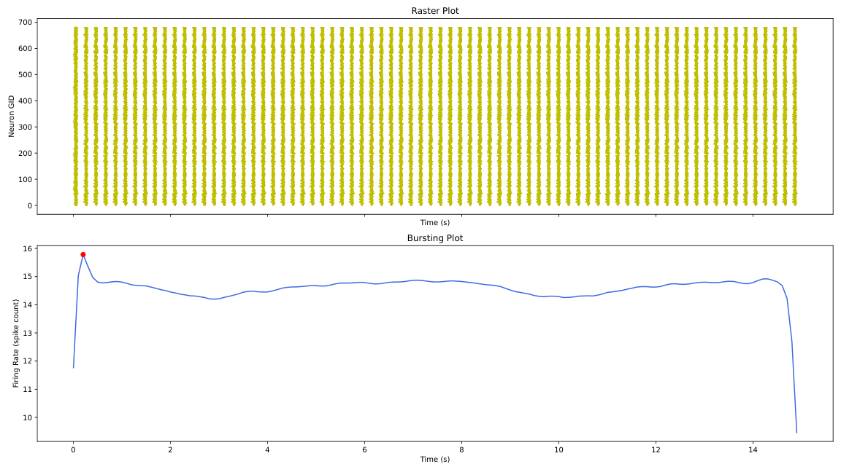
gen_2_cand_32, Page 1

Slide 33
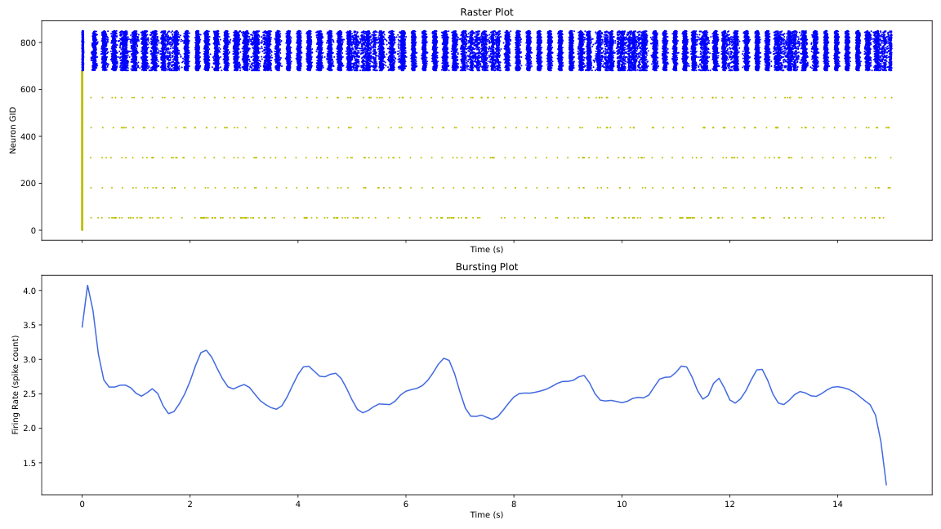
gen_2_cand_73, Page 1

Slide 34
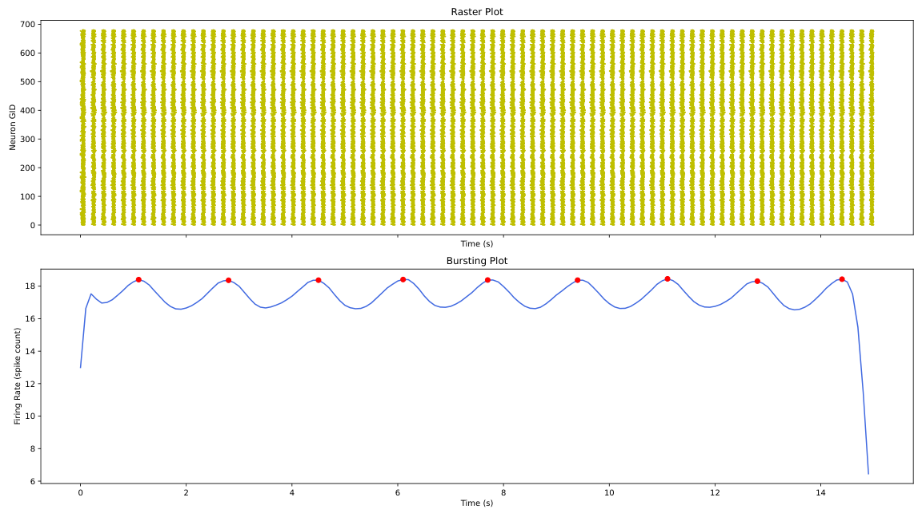
gen_2_cand_94, Page 1

Slide 35
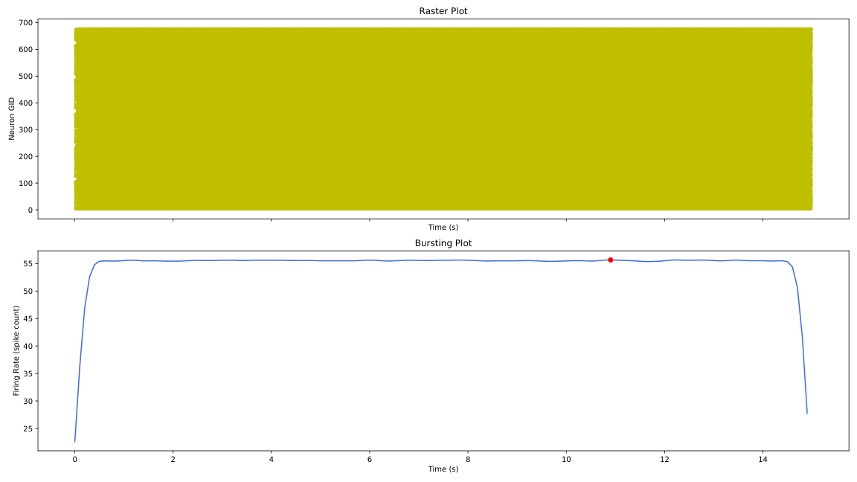
gen_2_cand_18, Page 1

Slide 36
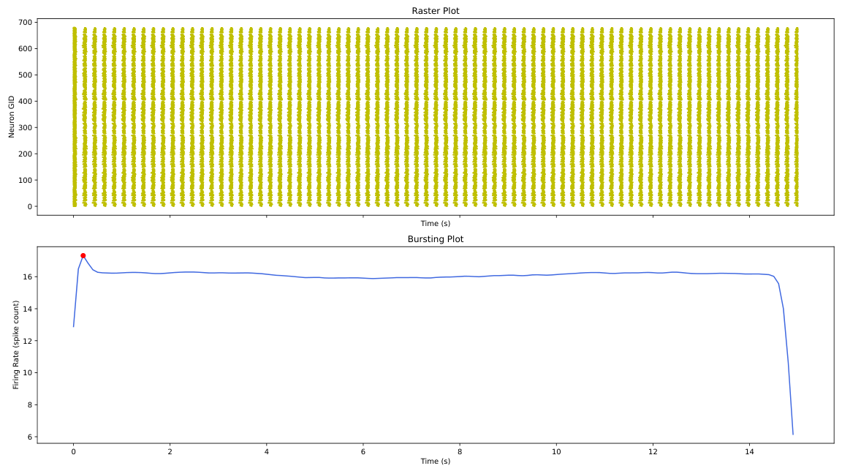
gen_2_cand_78, Page 1

Slide 37
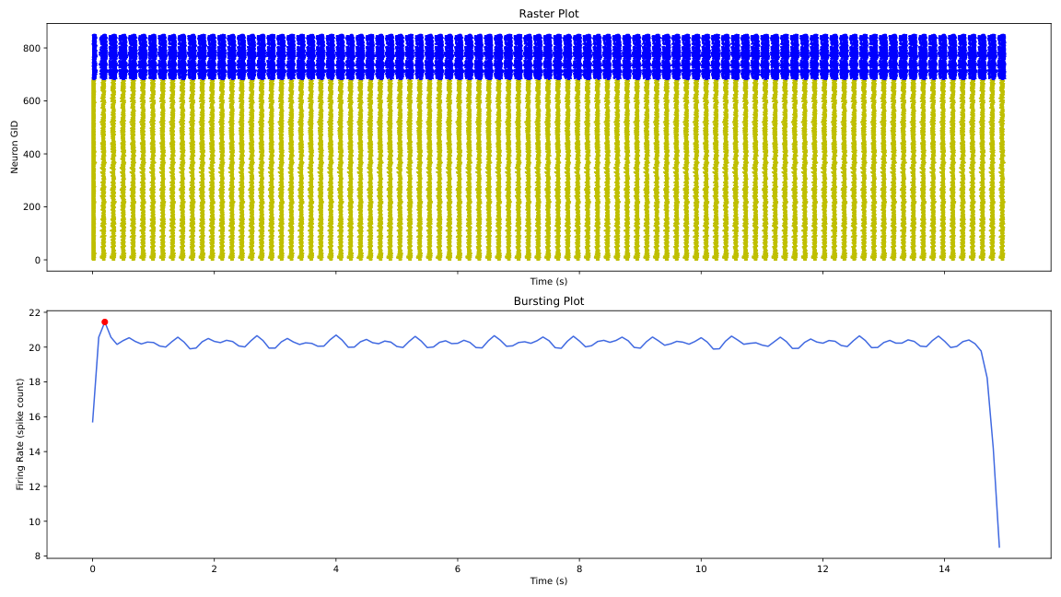
gen_2_cand_24, Page 1

Slide 38
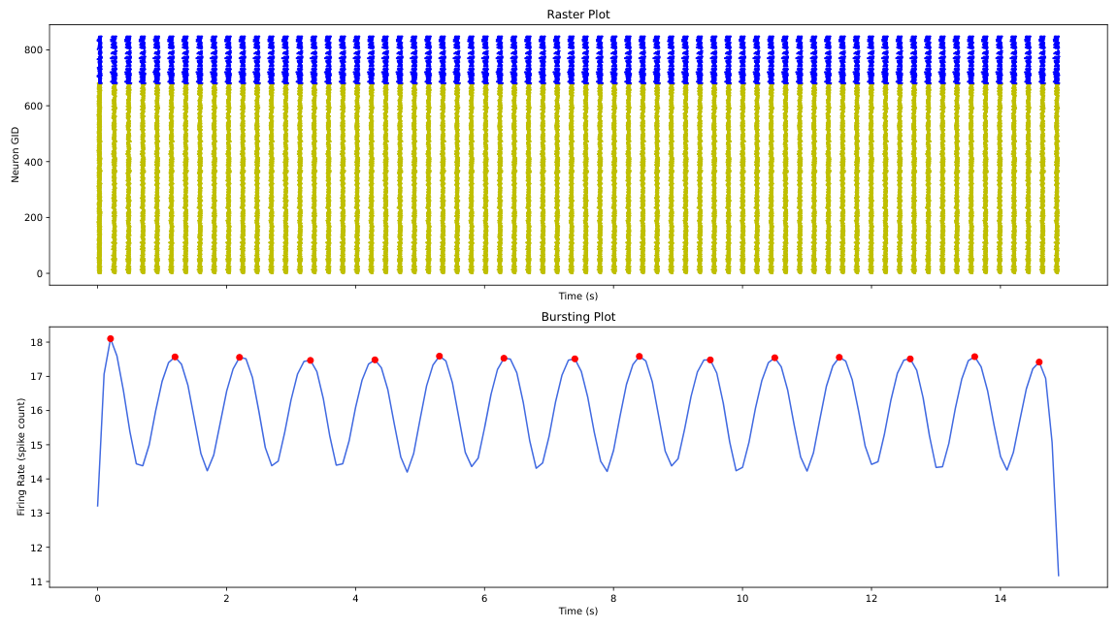
gen_2_cand_0, Page 1

Slide 39
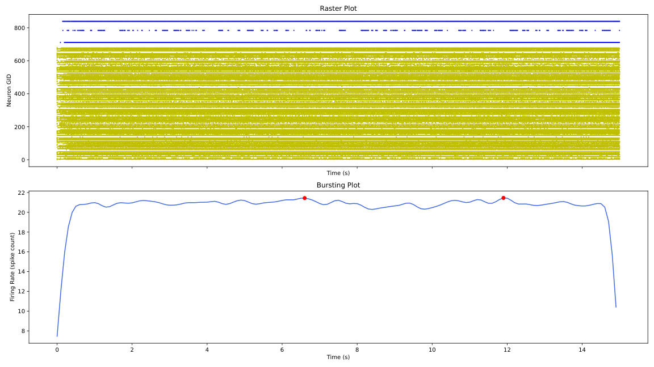
gen_2_cand_99, Page 1

Slide 40
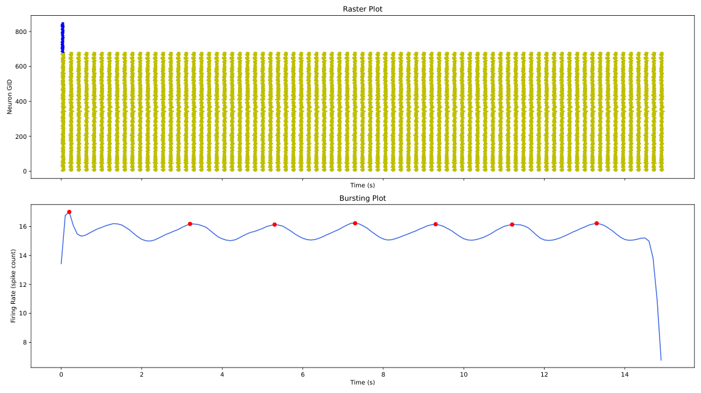
gen_2_cand_76, Page 1

Slide 41
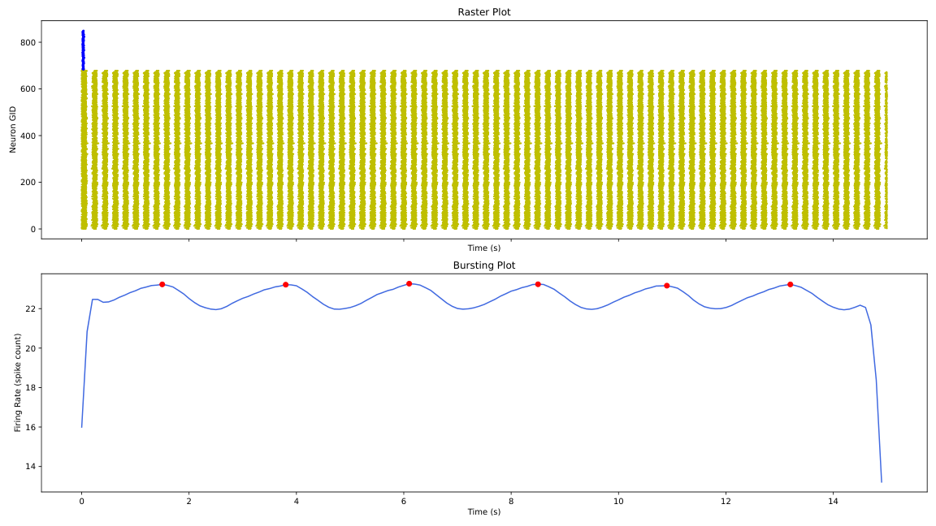
gen_2_cand_36, Page 1

Slide 42
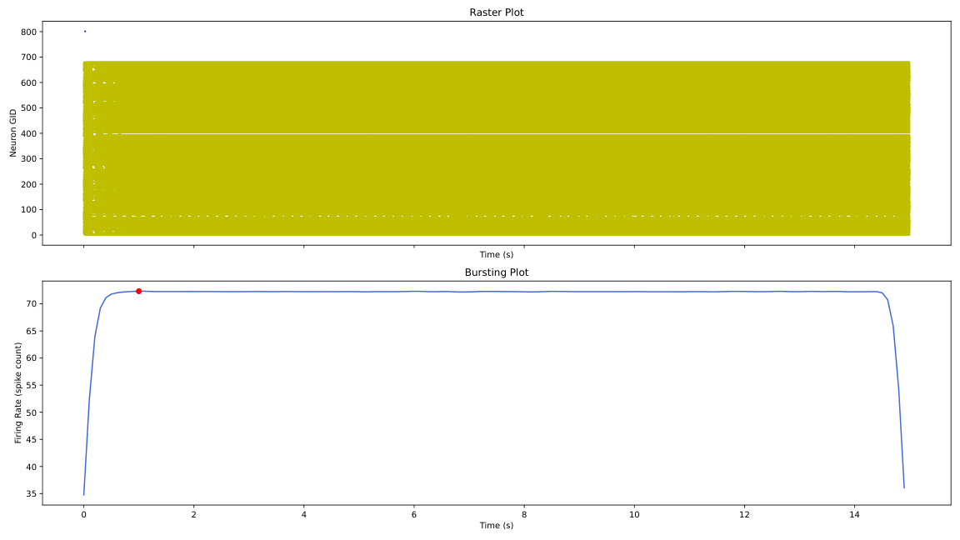
gen_2_cand_49, Page 1

Slide 43
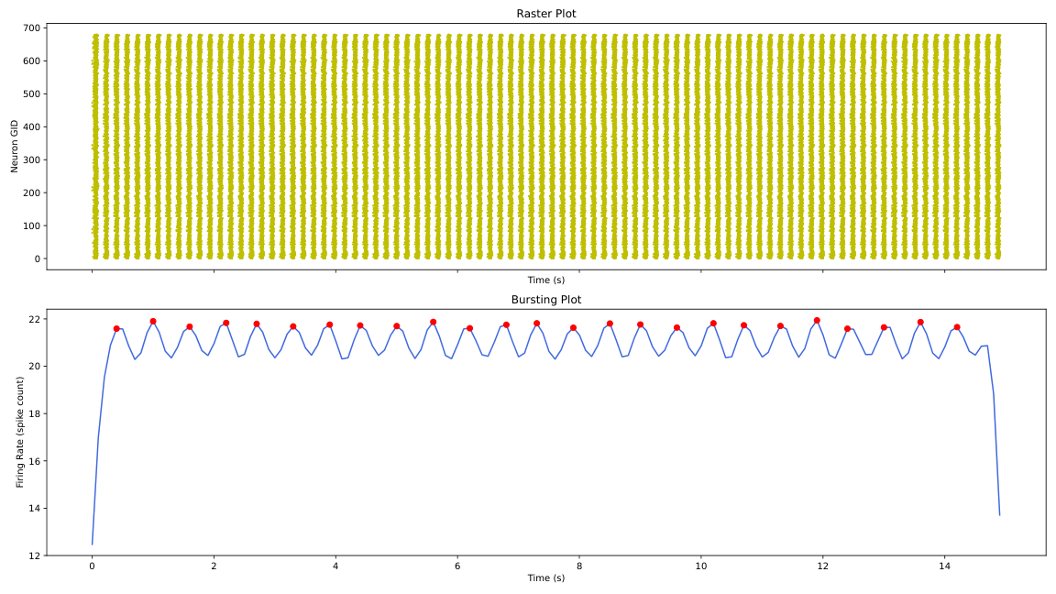
gen_2_cand_74, Page 1

Slide 44
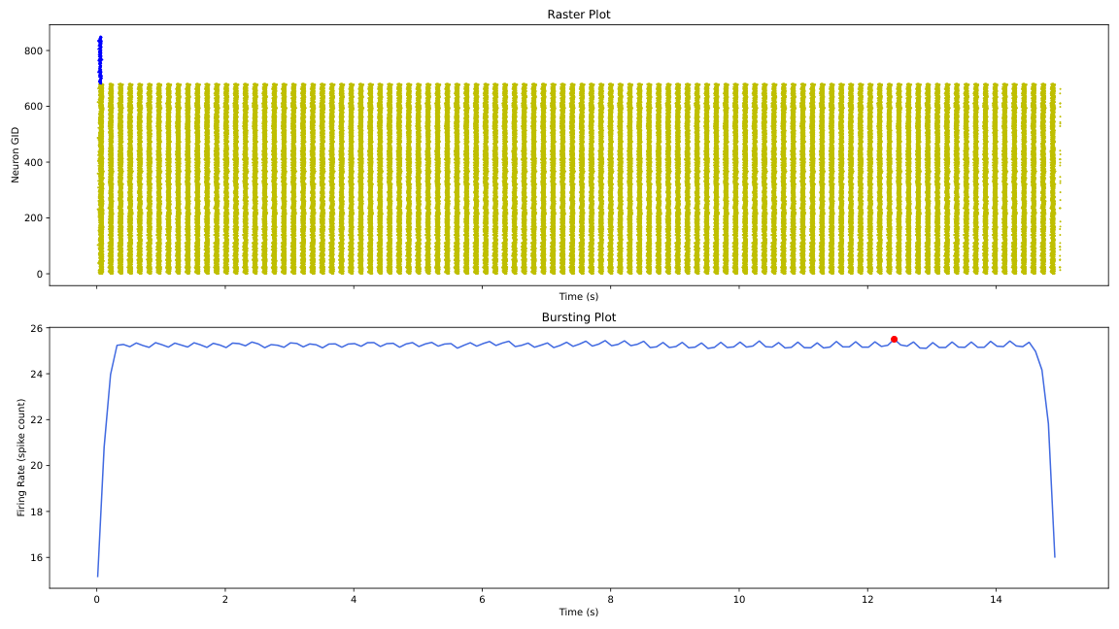
gen_2_cand_37, Page 1

Slide 45

gen_2_cand_27, Page 1

Slide 46
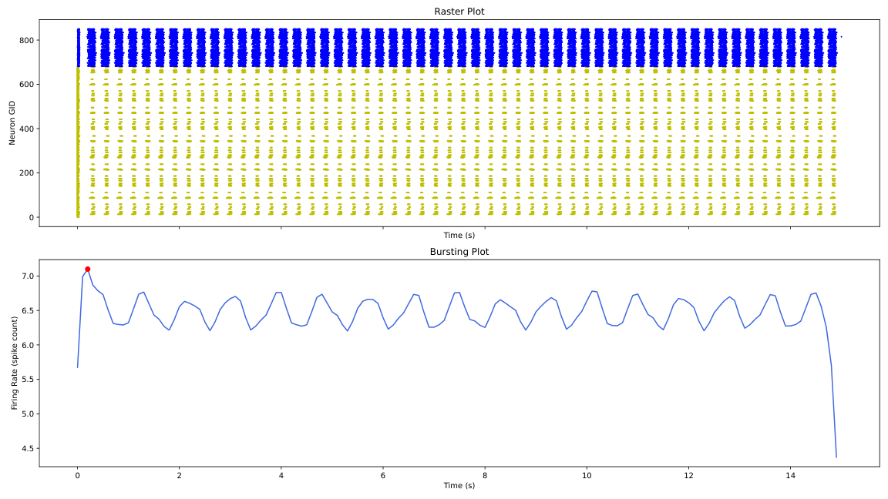
gen_2_cand_80, Page 1

Slide 47
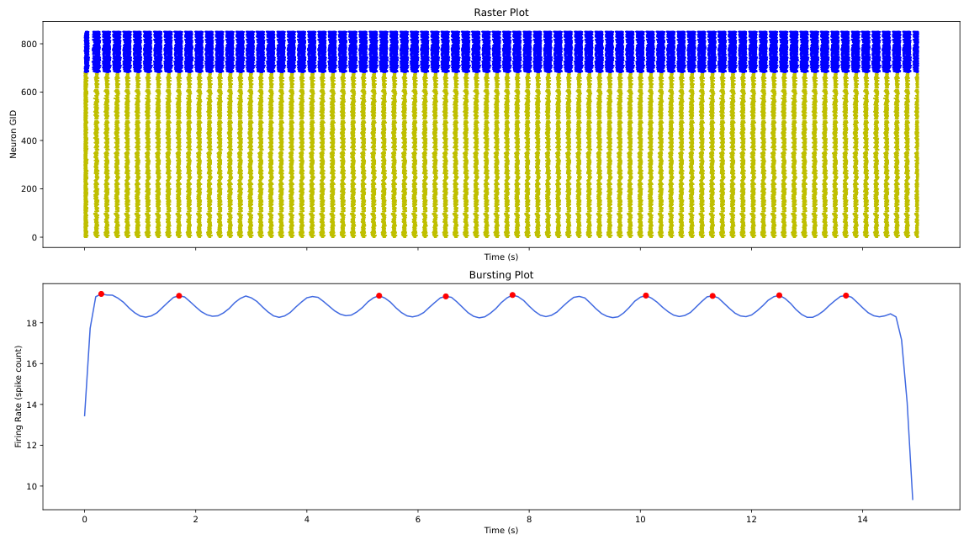
gen_2_cand_56, Page 1

Slide 48
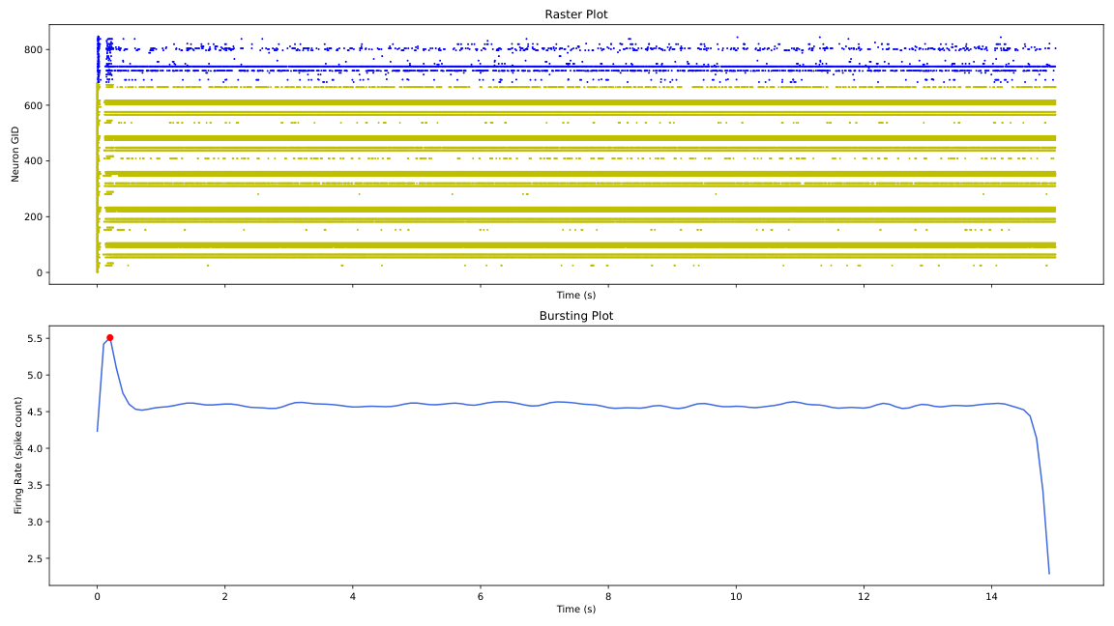
gen_2_cand_29, Page 1

Slide 49
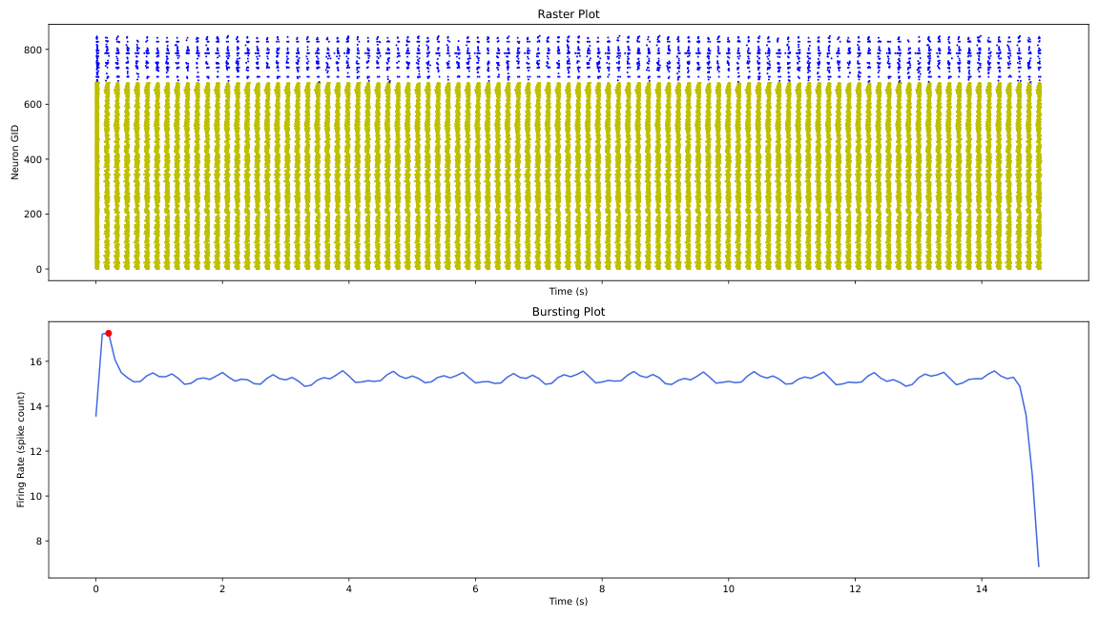
gen_2_cand_75, Page 1

Slide 50
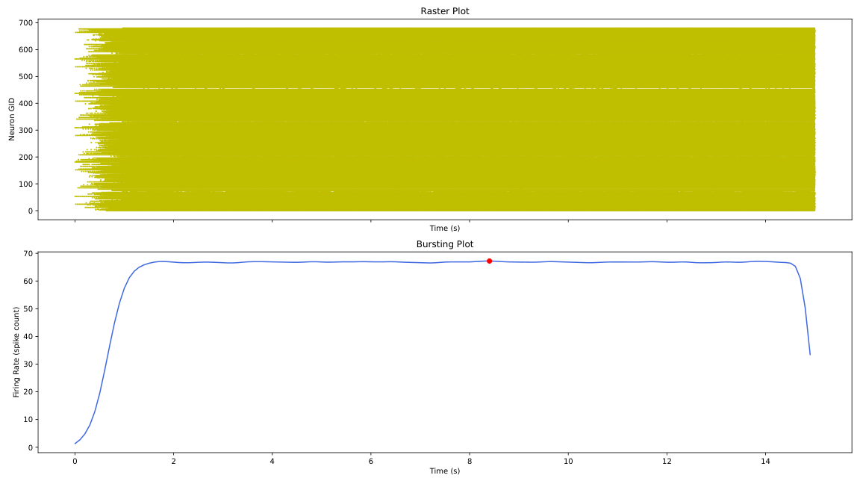
gen_2_cand_82, Page 1

Slide 51
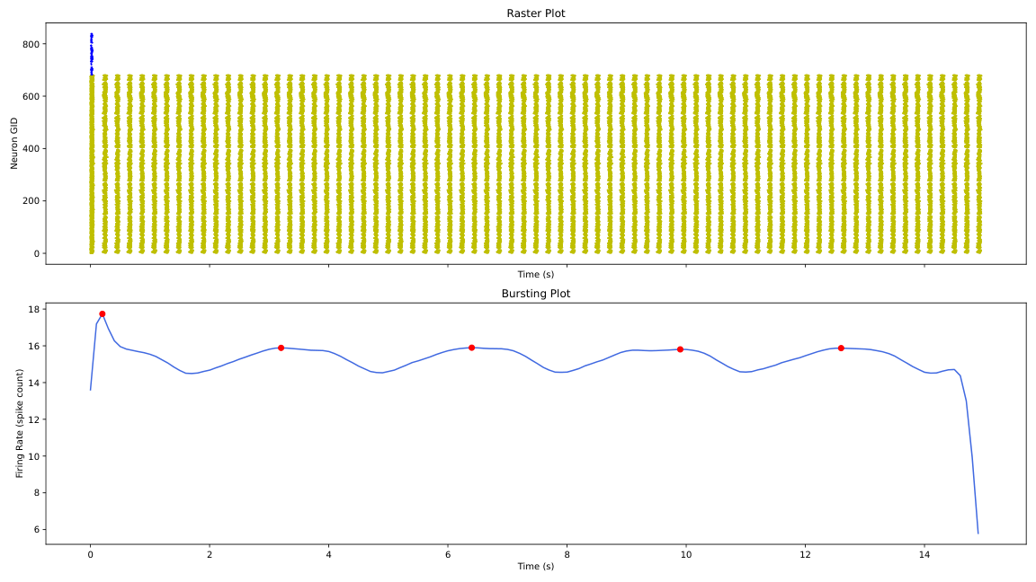
gen_2_cand_15, Page 1

Slide 52

gen_2_cand_17, Page 1

Slide 53
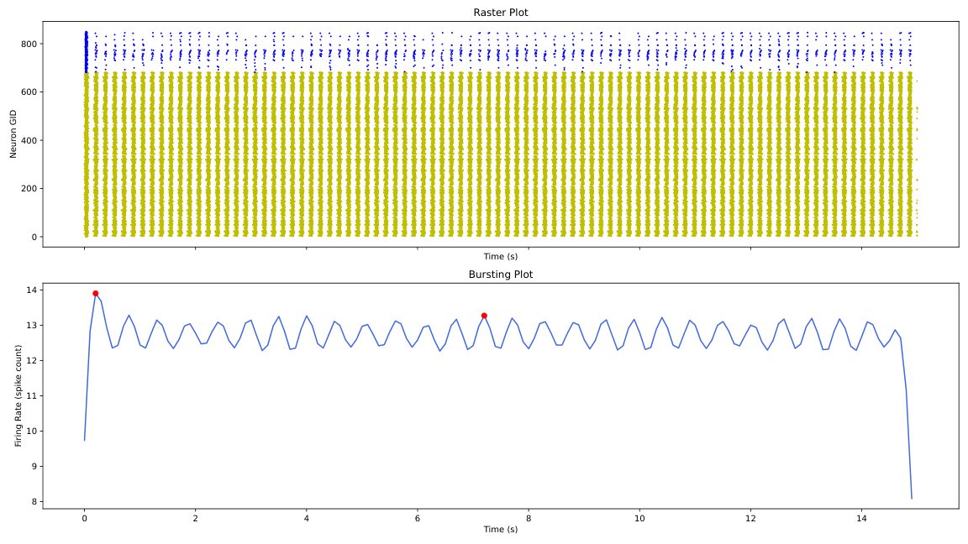
gen_2_cand_13, Page 1

Slide 54
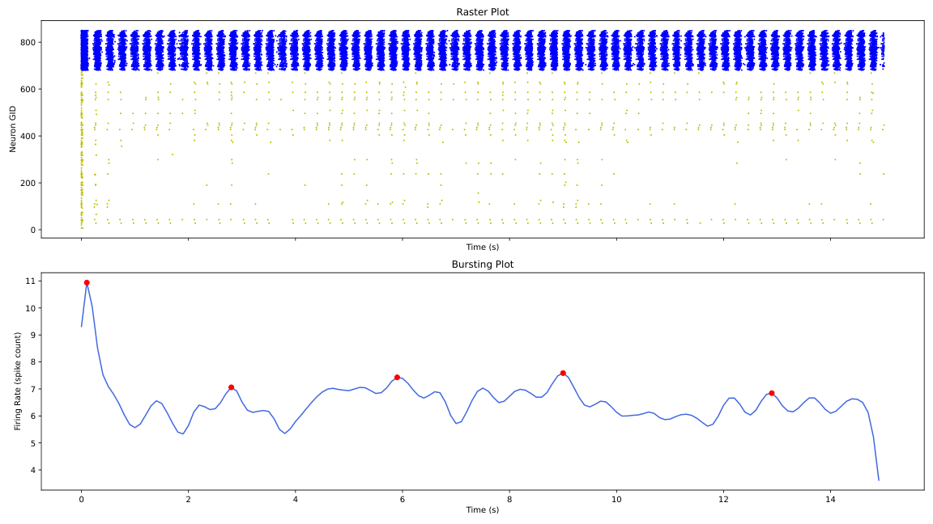
gen_2_cand_60, Page 1

